Slide 1
COGS 138 Week 2 Discussion Section
8th April 2024
Slides can be found on - https://github.com/n2mittal/COGS138-Sp24

Slide 2
Discussion Section
Walks throughs, Q/A, and discussion of the readings and the data science assignments
A space to collaborate and discuss group projects

Slide 3
Group Project
We want you to identify neuroscientific questions that are addressable by publicly available datasets. Specifically, you are required to choose between two options:
Choose a paper that uses a new data analysis technique that has been published no more than 10 years ago (most should have code and data publicly available). Implement this method using a new data set (either your own or from a publicly available source).
Come up with a neuroscientific research question of your own that is answerable with available data. You can look at some of the public datasets to frame your question. Determine an analytical approach that can be used to answer your question and implement this method.

Slide 4
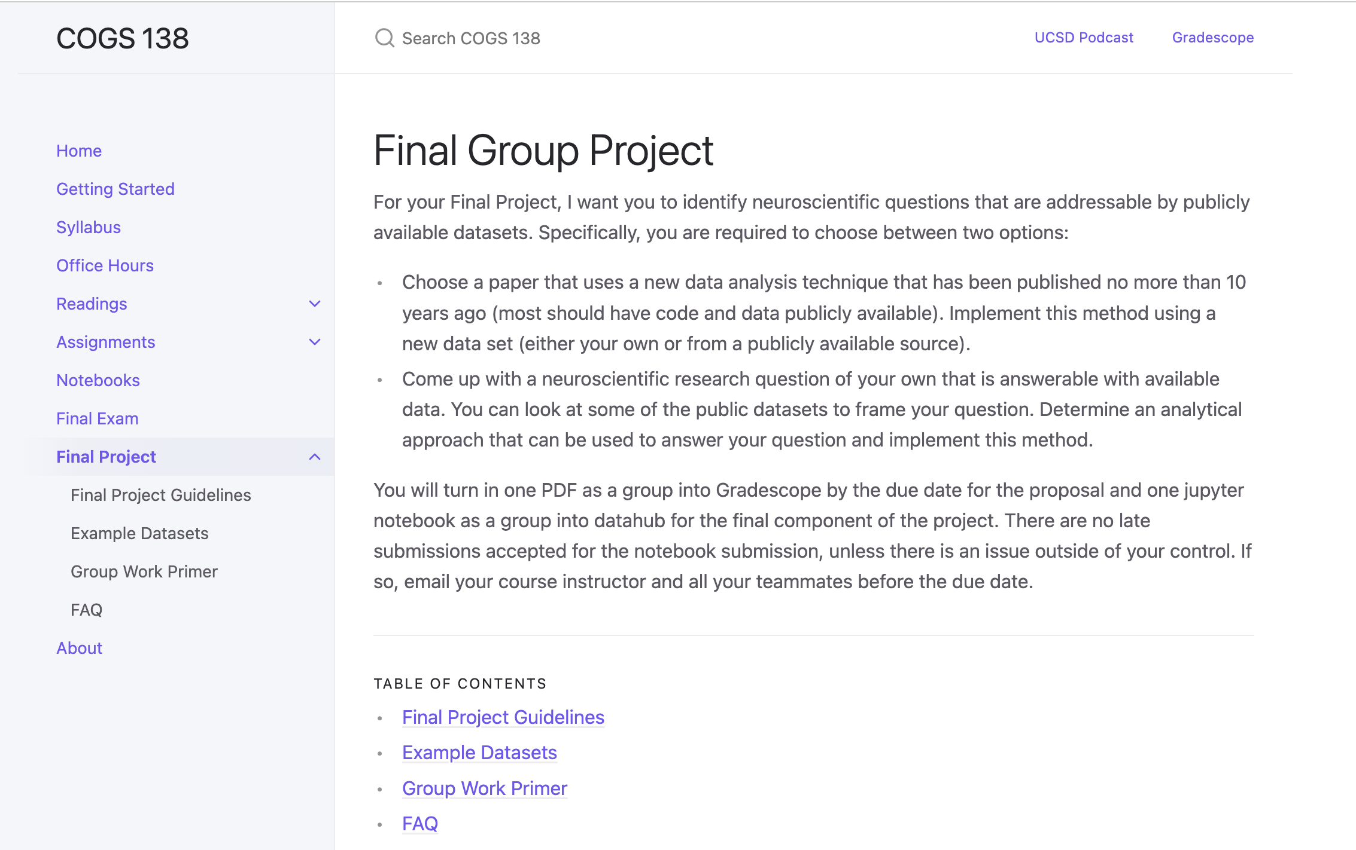
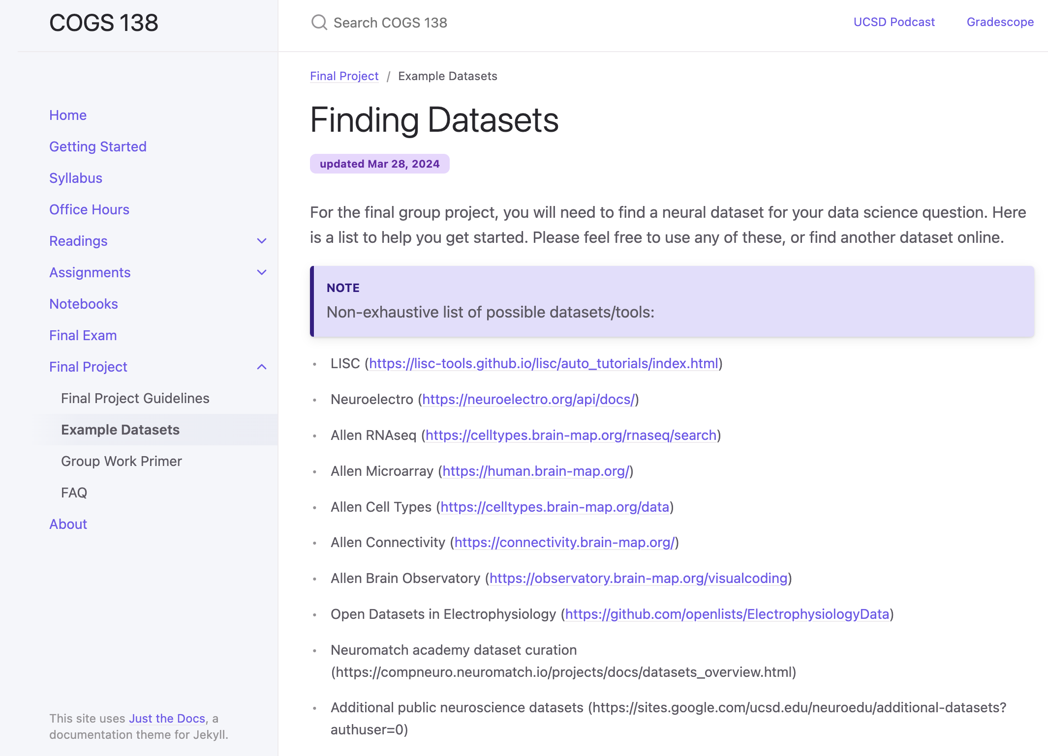
Group Project – Example Datasets

Slide 5
Group Project
There are some project ideas curated by the Neuromatch academy - https://compneuro.neuromatch.io/projects/docs/project_templates.html
If you are interested in questions related to visual or auditory perception, you can reach out to the professor. She has a couple of human fMRI datasets that were collected while humans watched a large number of images or listened to a bunch of sounds inside the scanner. She also has some language fMRI datasets that were collected while subjects listened to stories.
You can also choose to work with behavioral data and there are many public datasets for that as well.
Notes:
refer to this link for more ideas
She also knows of macaque electrophysiology datasets that were collected while macaques viewed images. She can point you guys to other open-source datasets for this.

Slide 6
Group Project
Project Overview: https://mkhosla-ucsd.github.io/cogs138/final-group-project/ (checklist, templates, datasets)
Example neuroscientific questions:
understanding how some aspect of the external world is encoded in patterns of brain
how brain regions are connected to each other
using brain imaging datasets/biomarkers for predicting the diagnosis of conditions like ADHD/autism.
You will turn in one PDF as a group into Gradescope by the due date for the proposal and one jupyter notebook as a group into datahub for the final component of the project.
Today in discussion section: Start thinking about group projects and looking for group members (3 - 4 members)
Notes:
There are useful publicly available datasets for answering each of these questions.

Slide 7
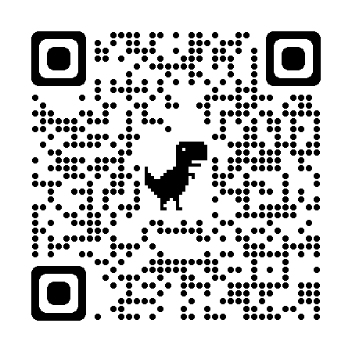
Submit your groups here:

Slide 8
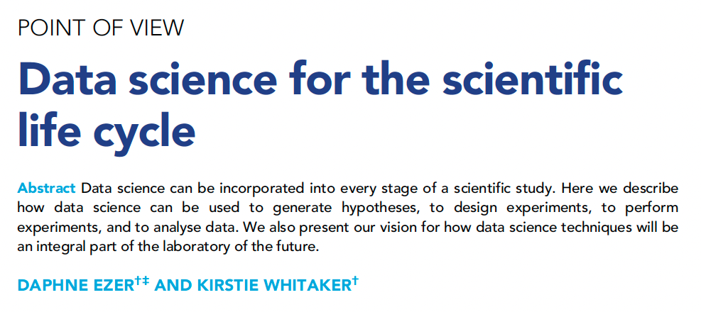
Reading 1
Notes:
This reading discusses how data science techniques can be incorporated into every stage of the scientific research process to improve efficiency and quality. The authors describe their vision for how data science will be an integral part of the future laboratory.

Slide 9
Traditional Scientific Process
Observe and generate hypothesis
Design experiment
Perform experiment
Analyze data
Evaluate hypothesis
Notes:
Traditionally, the scientific process involves observing phenomena, generating a hypothesis, designing and performing an experiment to test the hypothesis, analyzing the data, and evaluating whether the hypothesis is supported or not. However, there are obstacles at every step that data science may be able to help overcome.

Slide 10
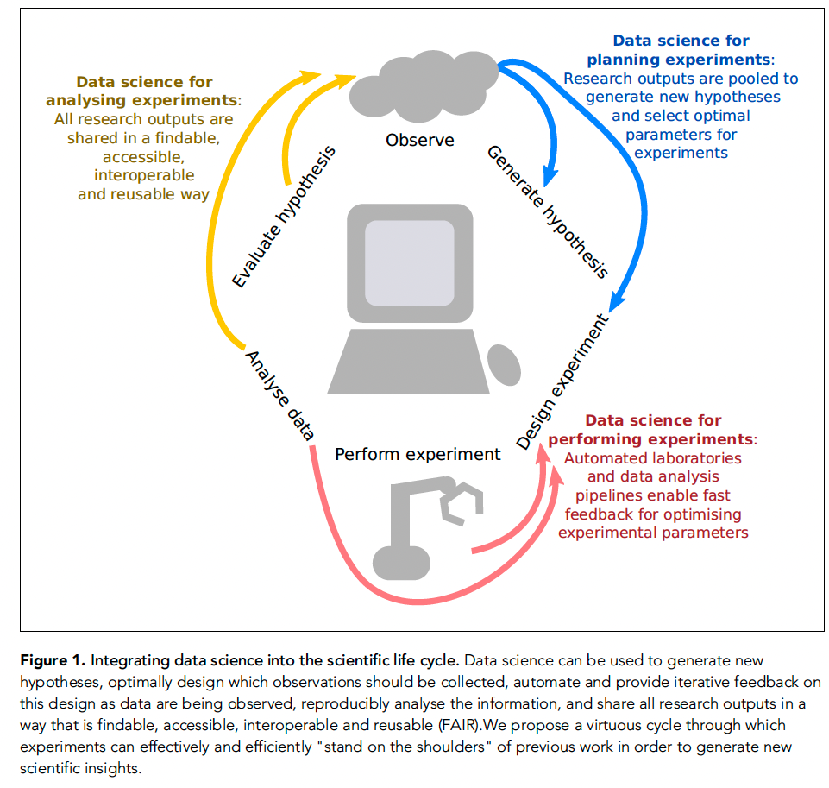
How can we apply the framework of data science to scientific research?

Slide 11
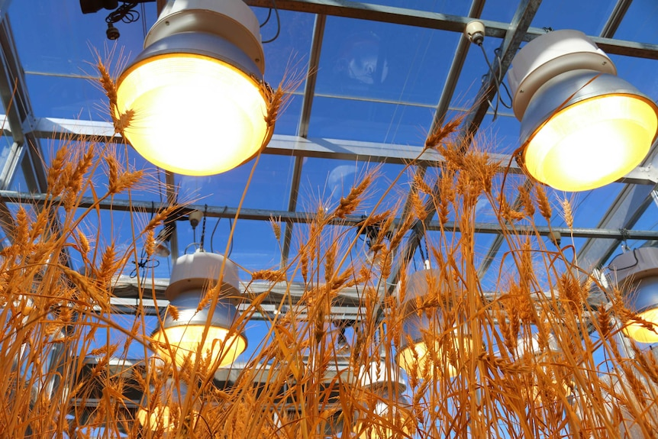
Data Science for Planning Experiments
Scientific questions → Optimization problems
Tweak parameters of your experiment, then iterate
Example: Fit a model of how temperature and light exposure influence wheat growth
What unforeseen aspects of this experiment may influence the results?
Notes:
Hypothesis-driven research usually requires a sci-
entist to change an independent variable and
measure a dependent variable. However, there
are often too many parameters to take account
of. In plant science, for instance, these parame-
ters might include temperature, exposure to
light, access to water and nutrients, humidity
and so on, and the plant might respond to a
change in each of these in a context-dependent
way.
For instance, let us say that a scientist wants
to fit a regression model of how temperature
and light exposure influence wheat growth. Ini-
tially they might measure the height of the
wheat at a number of combinations of tempera-
ture and light exposure. Then, the scientist could
ask: what other combinations of temperature
and light exposure should I grow the wheat at in
order to improve my ability to predict wheat
growth, considering the cost and time constraints of the project?

Slide 12
Data Science for Planning Experiments
Optimal experimental design
Select parameters to improve predictive models
Involve statisticians early
Notes:
Data science can help plan experiments through optimal experimental design - selecting which observations and parameter values to test in order to build the best predictive models within cost/time constraints. Statisticians should be involved from the start to frame the scientific question as an optimization problem.

Slide 13
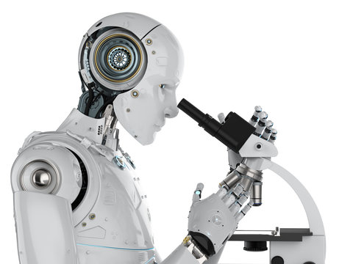
Data Science for Performing Experiments
Laboratory automation via “ROBOT SCIENTISTS”
They “use machine learning to generate hypothesis, plan experiments, and perform deductive reasoning to come to scientific conclusions”
Formal language to report scientific results
Improves reproducibility
Iterative workflows
Data collected by robots should be used to plan the next experimental procedure
Notes:
Robot scientists and automated lab pipelines can physically perform experiments based on computer programs. They “use machine learning to generate hypothesis, plan experiments, and perform deductive reasoning to come to scientific conclusions”. Publishing executable protocols alongside results can improve reproducibility. Incoming data from robots can provide iterative feedback to adaptively update the experimental parameters.

Slide 14



Data Science for Reproducible Data Analysis
How to aim for full replication when publishing scientific results:
Interactive notebooks
Jupyter, Rmarkdown
Version control and collaboration
Git, GitHub, GitLab
Package managers
Conda, Docker
Workflows
Travis CI
Open-source software and data
Open Microscopy Environment (OME)
FAIR: Findable, Accessible, Interoperable, Reusable
Notes:
Data science tools like version control, notebooks, and containerization can make data analysis reproducible. Following the FAIR principles of findable, accessible, interoperable and reusable data is key. Sharing analysis code, data and computational environments is critical.
OME - a set of open-source software and format standards. OME is committed to building and releasing high quality, open source, well-supported software for the scientific imaging community. Our tools should work regardless of location, processing environment or data type.

Slide 15
Data Science for Hypothesis Generation
We should be utilizing technology and data science to create new ideas!
Humans have a limited set of knowledge as well as unconscious biases
Literature mining
Exploratory meta-analysis of pooled datasets
Automated, reproducible process
Notes:
Machine learning techniques like text mining of publications and exploratory analysis of combined datasets from multiple labs can systematically generate new hypotheses in an automated, transparent way. This overcomes individual biases and scalability limits of manual hypothesis generation.

Slide 16
Challenges of Translating Theory into Practice
Interpreting experimental outcomes
Machine-readable --> human-readable
Positive feedback loops and algorithmic bias
Using the same model organisms because that is what our predecessors used
Algorithmic bias due to biased input data
Implementation and training
Version control, programming languages, statistics, robotics engineering
Infrastructure and accessibility globally
Augmentation, not automation
Data science as supplementing human research, not replacing it
Less ‘busy work’, more unique human thinking
Notes:
Challenges include balancing interpretable vs blackbox predictive models, avoiding societal biases being amplified, providing training for needed skillsets, building and maintaining infrastructure, and ensuring global accessibility to these technologies.

Slide 17
Vision for the Future Lab
Humans provide creativity and context
Automation of routine tasks
Seamless integration of techniques
Open sharing of all outputs
Notes:
The vision is for future labs where humans focus on the creative aspects like designing new protocols and providing context, while automation handles routine tasks. There will be seamless integration of techniques from planning to analysis. And all research outputs - data, code, protocols - will be openly shared.
Some first steps scientists can take today include using available tools for optimal experimental design, publishing reproducible protocols and analyses, leveraging open data repositories, and employing literature mining methods for new hypothesis generation.

Slide 18
General Announcements & Reminders
Quiz 1 due this Friday (12th April 2024)
No time limit on quizzes (updated policy)
Resubmissions are accepted until due date
Assignment 1 due next Monday (15th April 2024)
Assignment to be submitted on datahub

